Slide 1

COMP 4081: Software Engineering
Fall 2019
Dr. Scott Fleming, Instructor
TBA, Teaching Assistant
http://flic.kr/p/3f1RGT

Slide 2
Questions!
What are SE projects like?
What knowledge/skills must SEs master?

Slide 3
Questions!
What are SE projects like?
What knowledge/skills must SEs master?
Caveat: Every project is an individual

Slide 4


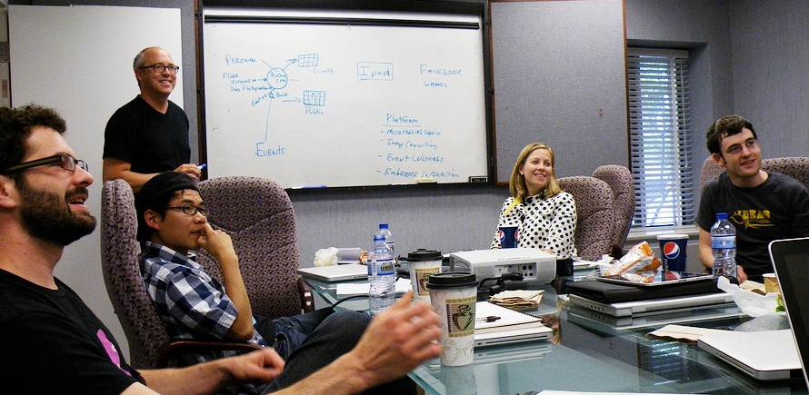
Characteristics of SE Projects
Large Scale
Customers
Teams of Developers
http://flic.kr/p/83MmEP
http://flic.kr/p/hnrKZ
http://flic.kr/p/sAPm8

Slide 5
What is the measure of a successful software engineering project?

Slide 6

What is the measure of a successful software engineering project?
Customer Satisfaction
http://flic.kr/p/hnrKZ
* OK, effect on society and humanity matters too, but humor me…

Slide 7
What do customers want?

Slide 8
What do customers want?
Software that
Meets their needs,
On time,
and
On budget

Slide 9

Unfortunately, satisfying customers is hard…
http://flic.kr/p/7pGoCd
Have you ever been a dissatisfied customer?

Slide 10
The “Software Crisis”
Since the 1960s
(More like a depression)
From the CHAOS Report 2015 by the Standish Group
Notes:
From the CHAOS Report 2015 by the Standish Group.
“All data, unless otherwise noted, represents results from FY2011-2015. The total number of software projects is 25,000-plus, with an average of 5,000 per yearly period.”

Slide 11

Even Big, High-Profile Projects Fail

Slide 12

Even Big, High-Profile Projects Fail

Slide 13
Questions!
What are SE project like?
What knowledge/skills must SEs master?

Slide 14
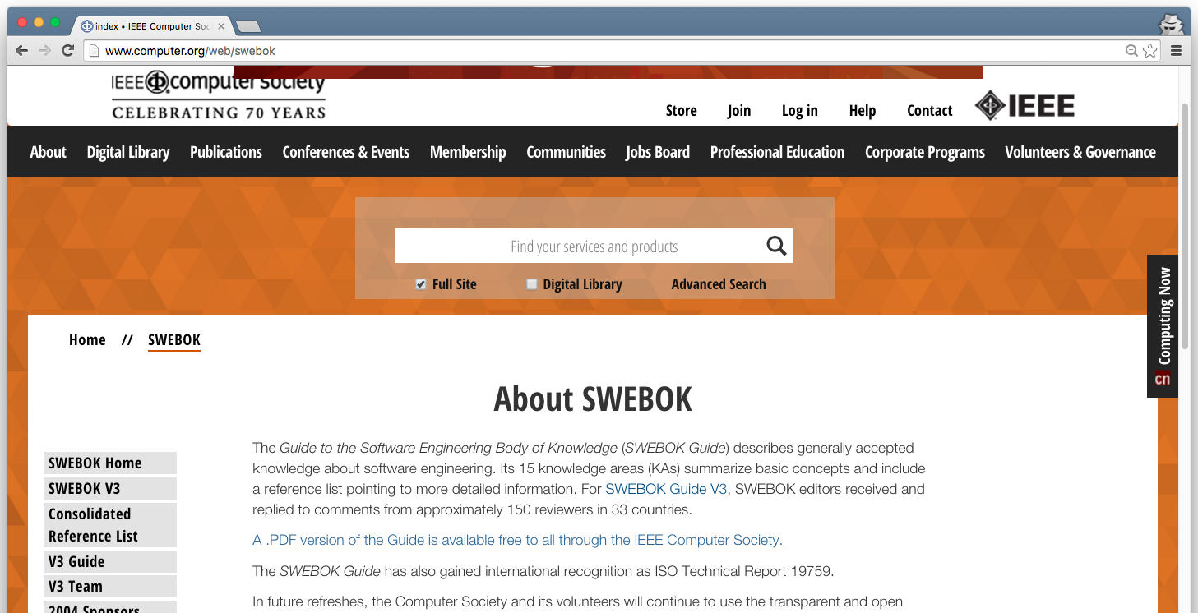
The SWEBOK (pronounced “SWEE-bock”) Software Engineering Body Of Knowledge SWEBOK Guide: http://www.computer.org/web/swebok

Slide 15
15 Knowledge Areas (KAs)
Software Requirements
Software Design
Software Construction
Software Testing
Software Maintenance
Software Configuration Management
Software Engineering Management
Software Engineering Process
Software Engineering Models and Methods
Software Quality
Software Engineering Professional Practice
Software Engineering Economics
Computing Foundations
Mathematical Foundations
Engineering Foundations

Slide 16
15 Knowledge Areas (KAs)
Software Requirements
Software Design
Software Construction
Software Testing
Software Maintenance
Software Configuration Management
Software Engineering Management
Software Engineering Process
Software Engineering Models and Methods
Software Quality
Software Engineering Professional Practice
Software Engineering Economics
Computing Foundations
Mathematical Foundations
Engineering Foundations
We’ll focus on this subset

Slide 17
Questions!
What’s an SE project like?
What knowledge/skills must SEs master?
How will you learn in this course?

Slide 18
Levels of Mastery
Familiarity
Understand what concept means
“What do you know about this?”
Usage
Use or apply concept
“What do you know how to do?”
Assessment
Justify selection of concept vs others
“Why would you do that?”
Which will be our focus?
From the ACM/IEEE Curriculum Guidelines for Undergraduate Degree Programs in Computer Science (2013)
Notes:
We use three levels of mastery, defined as:
● Familiarity: The student understands what a concept is or what it means. This level of mastery concerns a basic awareness of a concept as opposed to expecting real facility with its application. It provides an answer to the question “What do you know about this?”
● Usage: The student is able to use or apply a concept in a concrete way. Using a concept may include, for example, appropriately using a specific concept in a program, using a particular proof technique, or performing a particular analysis. It provides an answer to the question “What do you know how to do?”
● Assessment: The student is able to consider a concept from multiple viewpoints and/or justify the selection of a particular approach to solve a problem. This level of mastery implies more than using a concept; it involves the ability to select an appropriate approach from understood alternatives. It provides an answer to the question “Why would you do that?”

Slide 19
Levels of Mastery
Familiarity
Understand what concept means
“What do you know about this?”
Usage
Use or apply concept
“What do you know how to do?”
Assessment
Justify selection of concept vs others
“Why would you do that?”
This one!
From the ACM/IEEE Curriculum Guidelines for Undergraduate Degree Programs in Computer Science (2013)

Slide 20
Levels of Mastery
Familiarity
Understand what concept means
“What do you know about this?”
Usage
Use or apply concept
“What do you know how to do?”
Assessment
Justify selection of concept vs others
“Why would you do that?”
How do you learn usage?
Practice!
From the ACM/IEEE Curriculum Guidelines for Undergraduate Degree Programs in Computer Science (2013)

Slide 21
How You’ll Practice
Boot Camp
Significant software project
Team skills
Communication skills
Project management

Slide 22
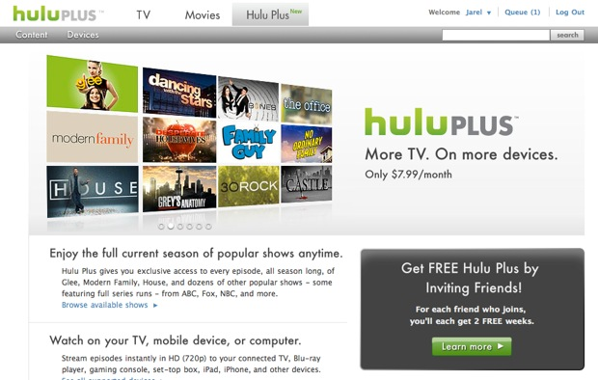
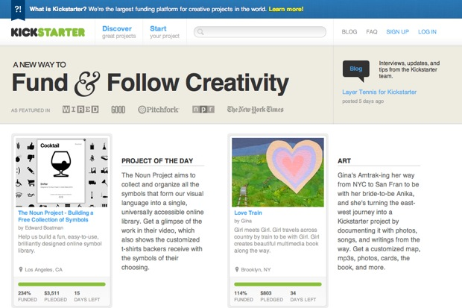

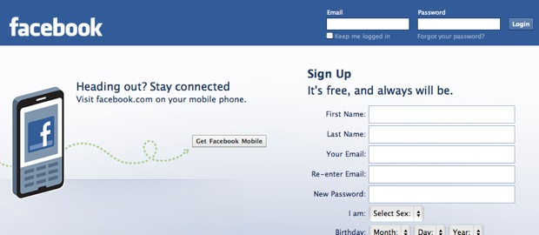
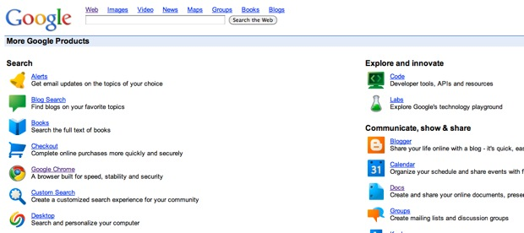
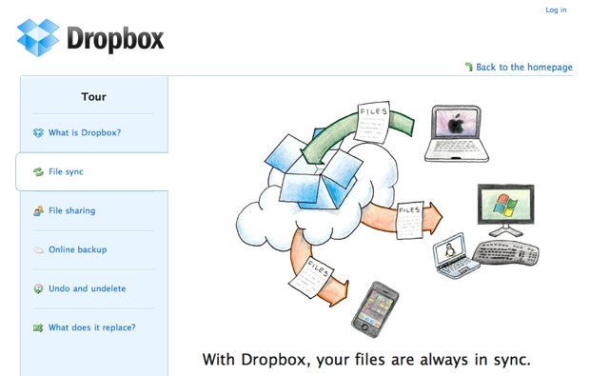
What type of software will you build for the project?
Web Apps!

Slide 23

Why web apps?
Every bit as dynamic and interactive as native apps
Avoid deployment problems
Reach people world wide
http://flic.kr/p/9DTDXi

Slide 24
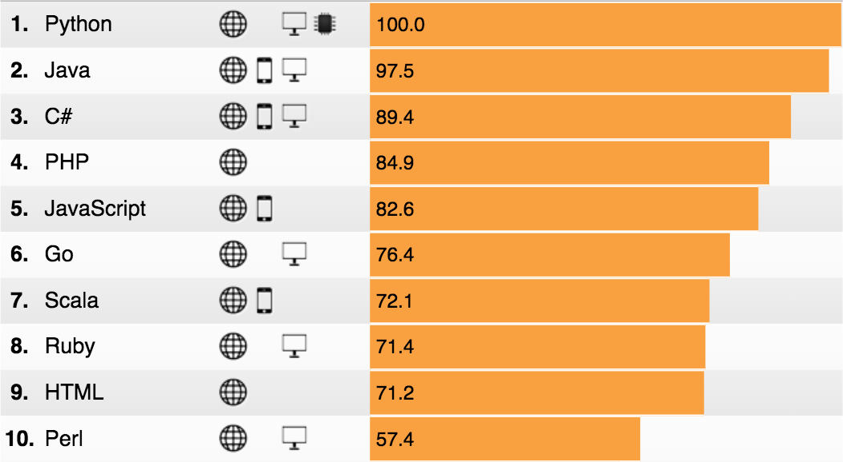
What programming language(s)?
http://spectrum.ieee.org/static/interactive-the-top-programming-languages-2018

Slide 25
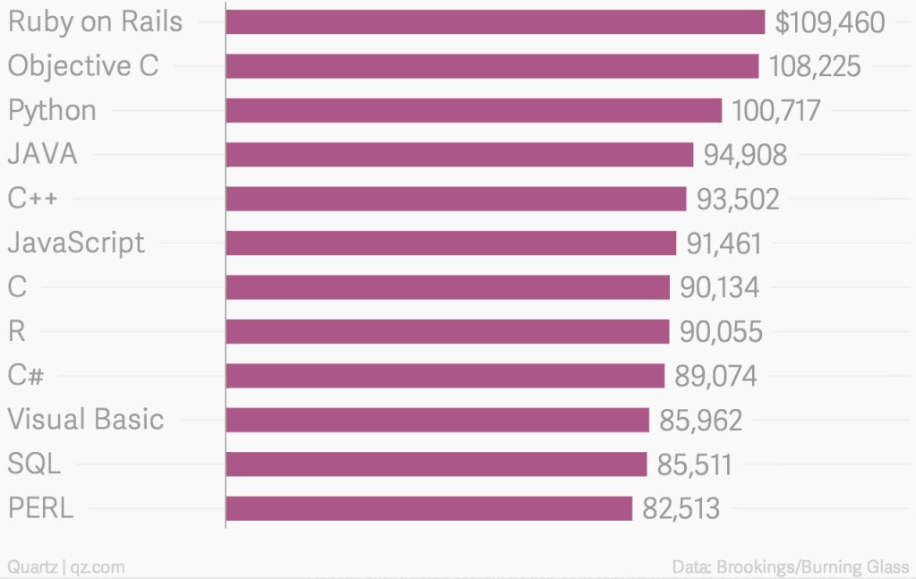
Most Valuable Skills on Resume (2014)

Slide 26
Course Structure
Rails Web App Boot Camp (7 weeks)
Weekly Homework
Team Project
Initial Planning (2 weeks)
Development Iteration 1 (3 weeks)
Development Iteration 2 (3 weeks)
Pop quizzes throughout
Two exams
Each project iteration ends with demos

Slide 27
Let’s tour the course syllabus and web pages and see what’s coming up…

